Slide 1



You’re Invited
NFFRFA’s Doug Milne Scholarship Fund Inc.*
“Our Largest Event
In Our 38 Year History”
Scholarship Awards / Charity Golf Events
Scholarship Award Activity 2022
Celebrating 2 Years / 24 Scholarships Recipients Value = $57,000
In Cooperation with

Slide 2



NFFRFA’s Doug Milne Scholarship Fund Inc.*
Scholarship Awards / Charity Golf
“2 Day Celebration”
Announcing 2022
38thAnnual
In Cooperation with:
Revised 3/31/22 Scholarship Awards Dinner
Revised 4/01/22 Charity Golf Tournament
Sign Up Today
Your Continued Support is Appreciated
For Additional Information Contact NFFRFA Executive Director
Tim McNamara
Email: mcnamara@coolfoodsnorthflorida.com
* NFFRFA Doug Milne Scholarship Fund Inc. is an approved IRS 501c3 Corp.

Slide 3
NFFRFA Doug Milne Scholarship Fund Inc.*
“Celebrating” 38 Years of …..
Developing Frozen / Refrigerated Foods with Southeastern Grocers and Consumers with
Themed Events That Follow NFRA’s Annual Marketing Plans while
Giving Back to the Community…… i.e.
8/19/21 - Awarding 22 Local College Students w/ 3.0 + GPA –
Majors in Related Frozen / Dairy industries additional $57,000
Total NFFRFA’s Lifetime
+$420,000*
In Cooperation with
SCHOLARSHIPS
* NFFRFA Doug Milne Scholarship Fund Inc. is an approved IRS 501c3 Corp.

Slide 4
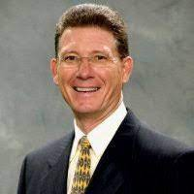


NFFRFA Doug Milne Scholarship Fund Inc.*
Keynote Guest Speakers
2 Day Event
North Florida Frozen Refrigerated Food Assn.
Revised 3/31/22 Scholarship Awards Dinner
Revised 4/01/22 Charity Golf Tournament
You’re Invited
Dewayne Rabon
SVP, Chief Merchant
Jeff Rumachik
NFRA Pres / CEO
Following All CDC Guidelines
* NFFRFA Doug Milne Scholarship Fund Inc. is an approved IRS 501c3 Corp.

Slide 5




NFFRFA Doug Milne Scholarship Fund Inc.*
You’re Invited Dinner
2022 Program - Day 1
3/31/2022 Check-In
Annual Scholarship Award Dinner
“Celebration”
Renaissance Inn World Golf Village
6–7 pm Registration / Welcome Reception
7–10 pm Dinner/ Guest Speakers
Followed by Scholarship Awards
Dinner Reception Area
Space Doubled
40% Improvement on
Dinning Seating =
From 10 per table to 6
Raffle Prizes Delivered
to your Table
Prizes Galore
Sign Up Today
Your Continued Support is Appreciated
Register Online WWW.COOLFOODSNORTHFLORIDA.COM

Slide 6

NFFRFA Doug Milne Scholarship Fund Inc.*
You’re Invited Charity Golf Tournament
2022 Program - Day 2
4/01/2022 Slammer & Squire @ World Golf Village St. Augustine
Charity Golf Celebration
$$ Prizes Galore
7:00 – 8:00 am Registration / Breakfast
8:00 AM Shotgun Start
12:00 – 1:00 PM Lunch / Awards / Raffle $$$
All Activities Held Outdoors + Special Festive 9th Hole
Special Feature Don’t Miss Fiesta Hole 9
Sign Up Today
Your Continued Support is Appreciated
Register Online WWW.COOLFOODSNORTHFLORIDA.COM

Slide 7
2022 Scholarship Dinner /Charity Golf Ala Carte Options*
Scholarship Award Dinner Ticket
  Scholarship Dinner (Member) $ 180.00
  Scholarship Dinner (Non Member) $ 225.00
Scholarship Charity Golf
  1 Foursome (NFFRFA Member) $1,600.00
  1 Foursome (Non-Member) $2,000.00
  Single Player (NFFRFA Member) $ 500.00
  Single Player (Non-Member) $ 600.00
  NFFRFA Annual Membership $ 200.00
  ( Year = May 1st 2021 – April 30th 2022)
Hole Sponsor w/ Company LOGO $ 250.00
* Additional Event Corporate Sponsorships Available Many Include Above Options
3 Convenient Payment Options
“PayPal” via Website, “Square” via NFFRFA Admin or via Invoice
(Simply note Payment Preference when registering)
Register Online WWW.COOLFOODSNORTHFLORIDA.COM
* NFFRFA Doug Milne Scholarship Fund Inc. is an approved IRS 501c3 Corp

Slide 8


World Golf Village Renaissance St. Augustine Resort for $149 USD per night
Book your group rate for NFFRFA Awards Dinner 2022
Click above link in Full Slide Show mode
NFFRFA Awards Dinner 2022
Start Date: 2022 March 31, Thu
End Date: 2022 April 01, Fri
Last Day to Book: 2022 Feb 28, Monday
Hotel(s) offering your special group rate:
Limited # of Rooms Available 500 S. Legacy Trail St. Augustine, Fl. 32092
or by calling (800)468-3571 and using group code (NFFNFFA).
The Slammer & Squire course is located in the heart of our golf resort near Jacksonville, Florida and is one of St. Augustine Florida's favorite golf courses. This 18-hole championship resort course was designed by Bobby Weed with design consultants Sam "The Slammer" Snead and Gene "The Squire" Sarazen.
COURSE HISTORY
The Slammer & Squire course officially opened to the public in May 1998 and has become a favorite Jacksonville Florida golf course and features two distinct nines with generous fairways, contoured greens, and plenty of water hazards along with impressive views of the World Golf Hall of Fame. The course was the host site of the Liberty Mutual Legends of Golf, a Senior PGA TOUR event and hosted an array of other golf events such as the LPGA Senior Tour's Honda Cup
For Additional Information Contact NFFRFA Executive Director
Tim McNamara (904) 234 5380
Email: admin@coolfoodsnorthflorida.com

Slide 9
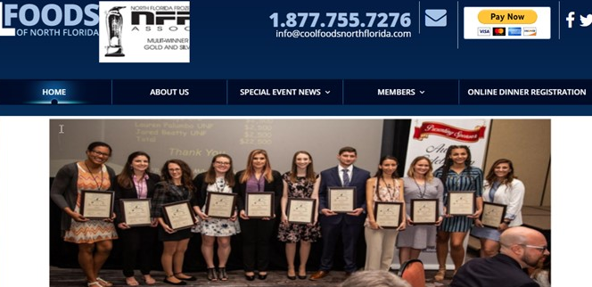
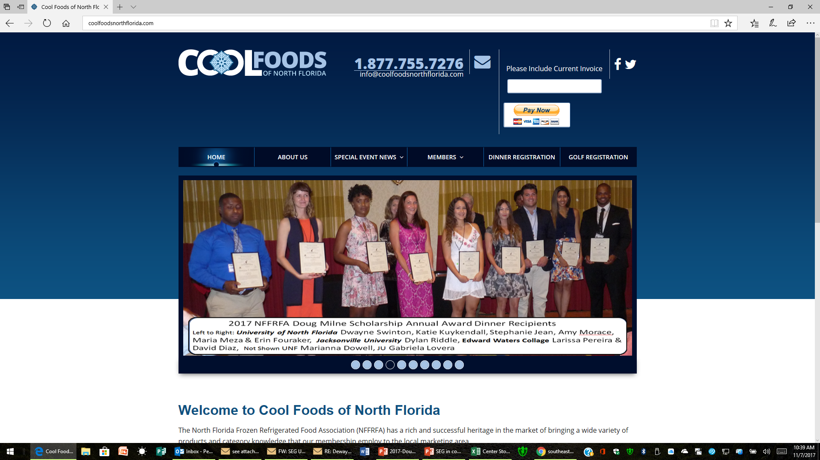

Don’t Delay Register Today Seating Is Limited
On Line Direct Dinner & Golf Registration
http://coolfoodsnorthflorida.com/
Click above link in Slide Show mode
Home Page
On Line Direct Hotel Registration
We have arranged w/ Renaissance for A Special Room
Rate @ $149 + tax Limited # of Rooms Available
500 S. Legacy Trail St. Augustine, Fl. 32092 904-940-8000
https://www.marriott.com/event-reservations/reservation-link.mi?id=1558617166278&key=GRP&app=resvlink
Click above link in Slide Show mode
Or by calling (800)468-3571 and using group code (NFFNFFA).
For Additional Information Contact
NFFRFA Executive Director
Tim McNamara (904) 234 5380
mcnamara@coolfoodsnorthflorida.com

