Slide 1
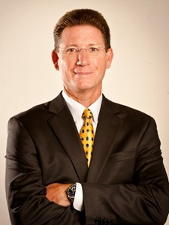

NFFRFA Doug Milne Scholarship Fund Inc.*
Proudly Announces
Southeastern Grocers
Dewayne Rabon
2018 Guest Speaker
2 Day Event
North Florida Frozen Refrigerated Food Assn.
5/3/18 Scholarship Awards Dinner
5/4/18 Charity Golf Tournament
You’re Invited
SVP, Merchandising and Fresh
* NFFRFA Doug Milne Scholarship Fund Inc. is an approved IRS 501c3 Corp.

